Slide 1
Best Practice Reminders for Cataloging Chinese Minority-Language Materials
Lauran R. Hartley
Tibetan Studies Librarian
March 22, 2018

Slide 2
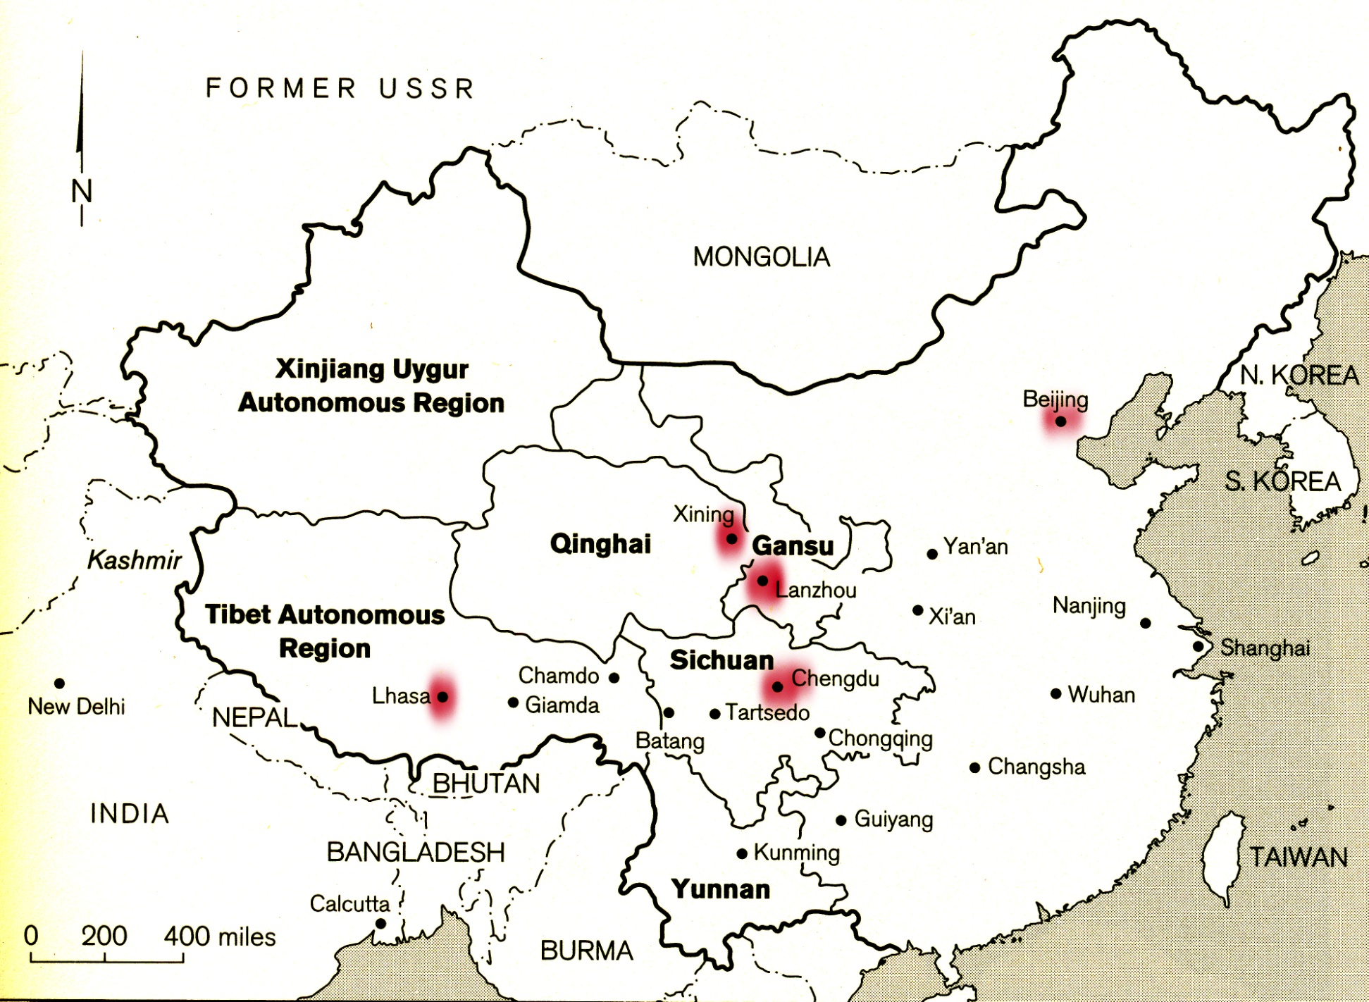
NATIONALITY PUBLISHING HOUSES FOR TIBETAN & OTHER LANGUAGE MATERIALS
Notes:
The locations of major and official Tibetan-language publishing centers in the People’s Republic of China.

Slide 3
TIBETAN
MANCHU
Notes:
The LC Romanization table for Tibetan, first developed in the 1960s, was revised in 2015.
The LC Romanization table for Manchu was revised in 2012.

Slide 4
Early Recipients of PL-480 Tibetan Materials
Notes:
In October 1961, a number of university libraries were asked by the Librarian of Congress if they were interested in receiving Tibetan-language materials. Eleven American university libraries accepted the invitation and agreed to a $500 yearly participation fee. The
LC Delhi Office was established in 1963. Among its missions is to respond to the informational needs of the Congress, US agencies and the scholarly community. The Tibetan scholar Gene Smith became director of this office in 1968. (source: Maureen Patterson, Journal of Asian Studies, no. 28, 743-754.)

Slide 5
14 Current SACAP Subscribers – Tibetan Program
University of California (Berkeley)
University of Chicago
University of Wisconsin
Columbia University
University of Virginia
University of Michigan
Harvard College Library
University of California (Los Angeles)
Indiana University
Tibetan Language Institute (Montana)
Emory University (since 2005)
Bodleian Libraries, Oxford University (since 2012)
Princeton University (limited subscription)
National Library of Medicine
Information courtesy of Library of Congress Delhi Office, July 14, 2013
Notes:
The South Asian Cooperative Acquisitions Program of the Library of Congress, which is seated in Delhi, India, has distributed Tibetan language materials to leading academic research libraries in North America since the 1960s. This list shows the current subscribers to the acquisitions program.

Slide 6
Recently Revived Tibetan Collections
2005
2011
2008/2012
2010
2012
Notes:
Whereas the establishment of Tibetan library collections previously coincided with or even spurred the growth of academic programs, we now see a reverse trend such that new academic hires or positions at certain universities have led to a revival of Tibetan-language acquisitions or even to new collections.

Slide 8
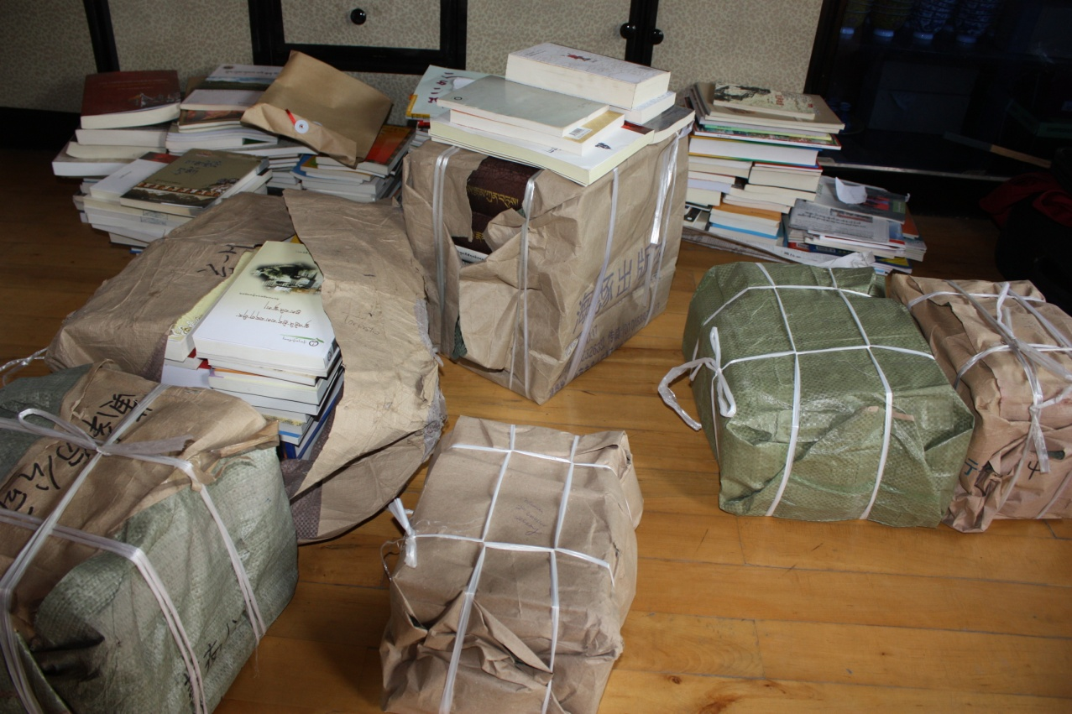

Slide 9
Packed for the Post Office, Lhasa, August 2013

Slide 10
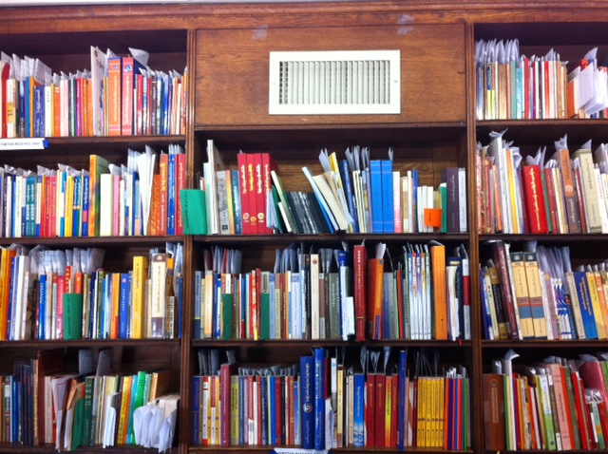

Slide 11
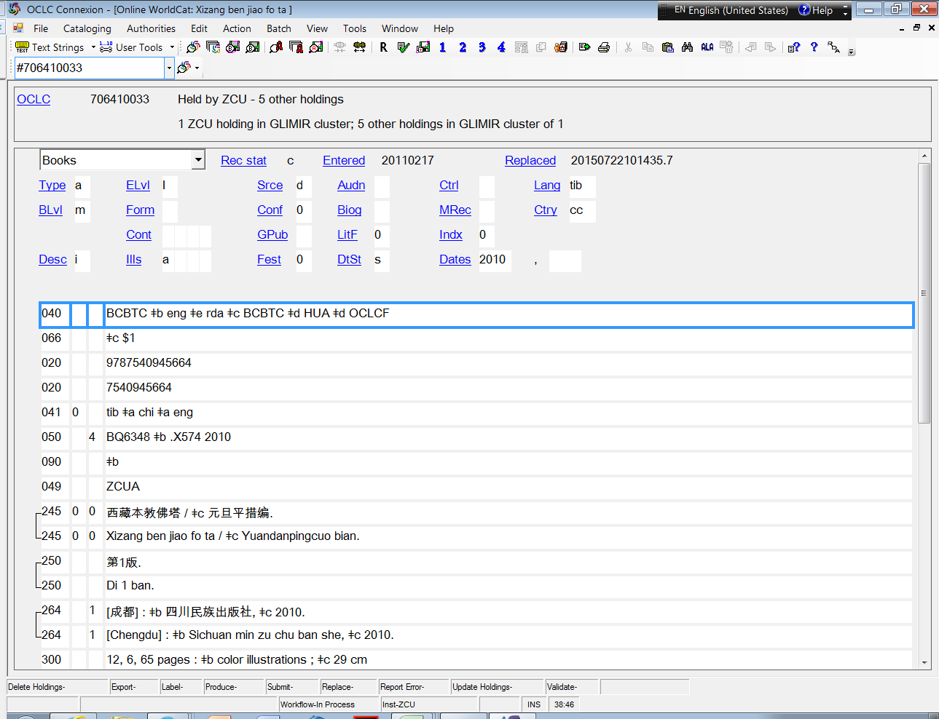
Example 1: Vendor record for Tibetan-language title – with all metadata in Chinese.

Slide 12
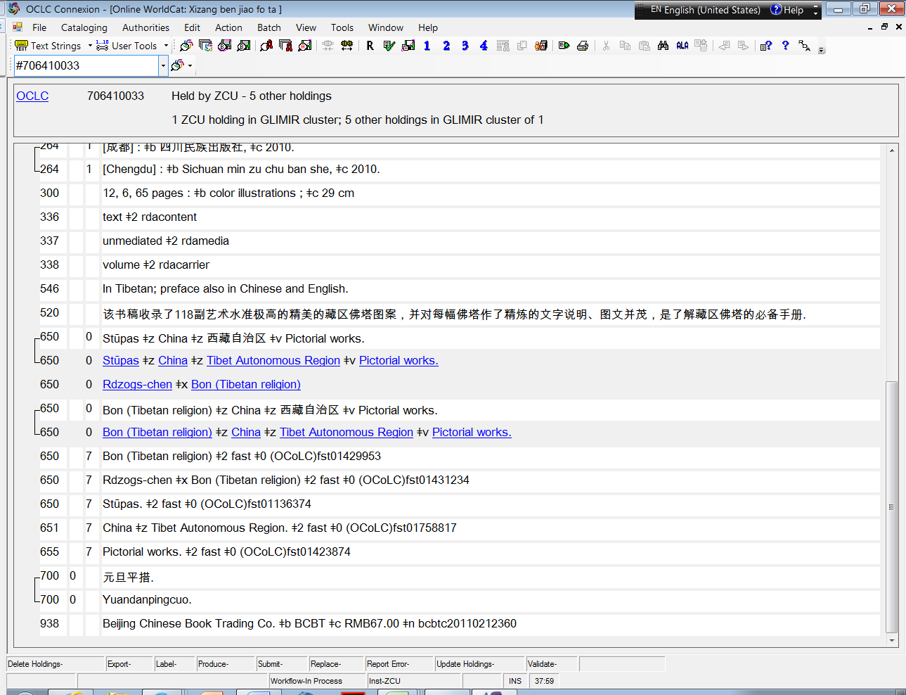

Slide 13
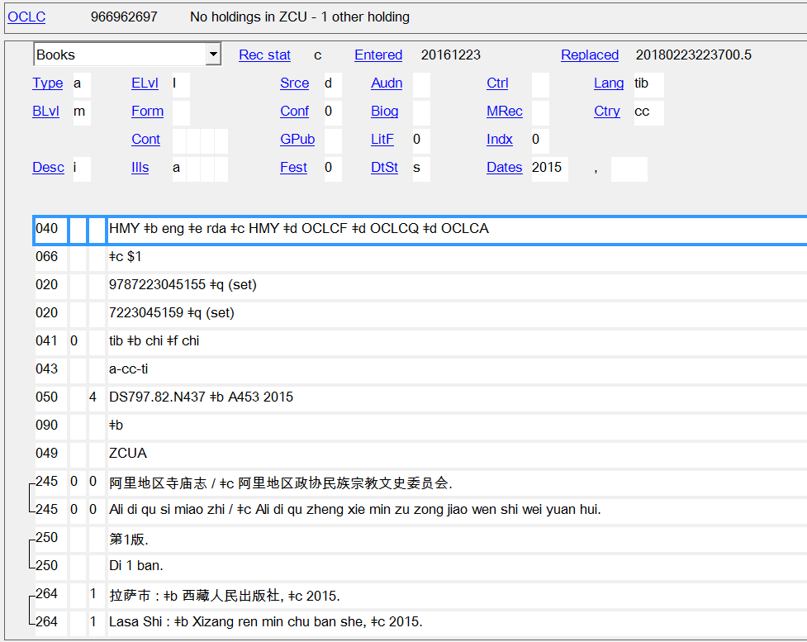
Example 2: Full-level record for Tibetan-language title

Slide 14
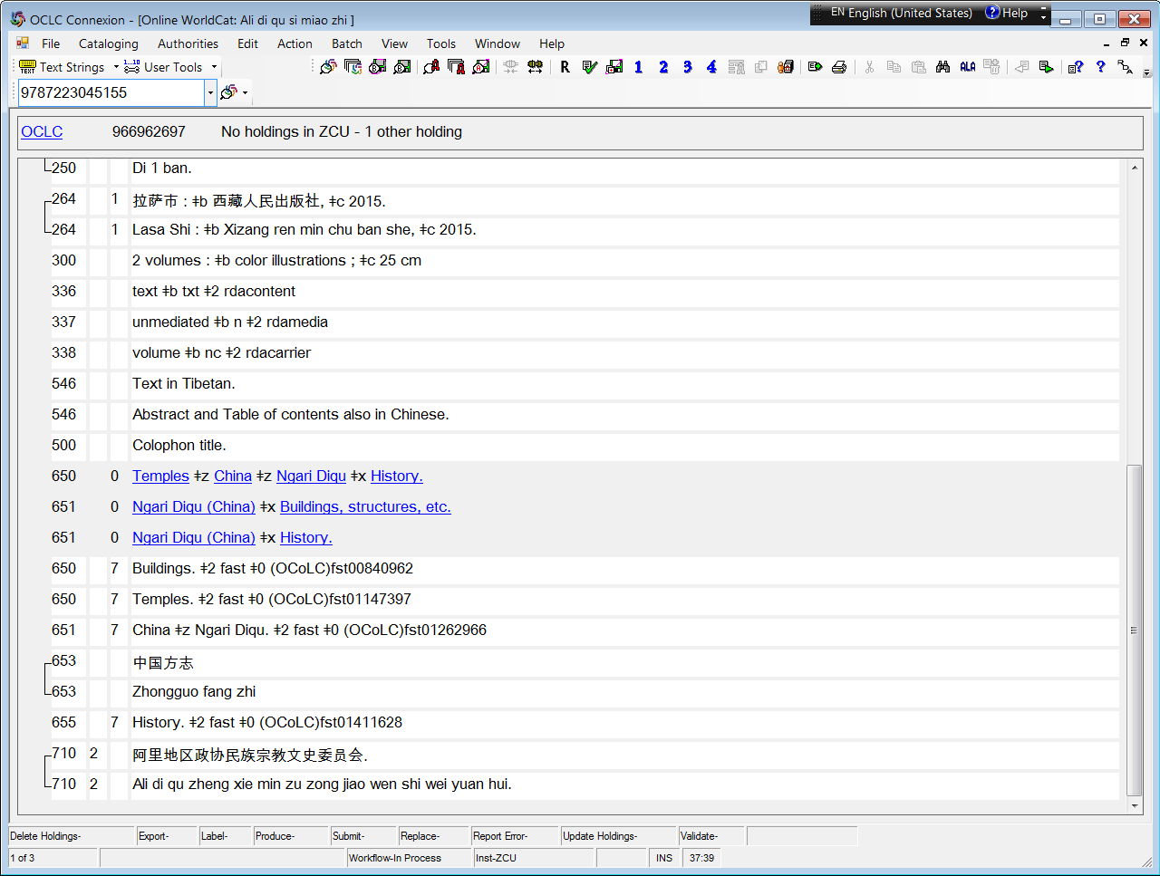

Slide 15
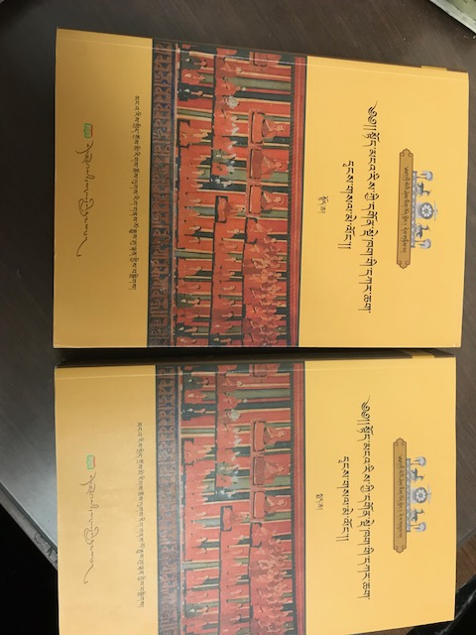

Slide 16
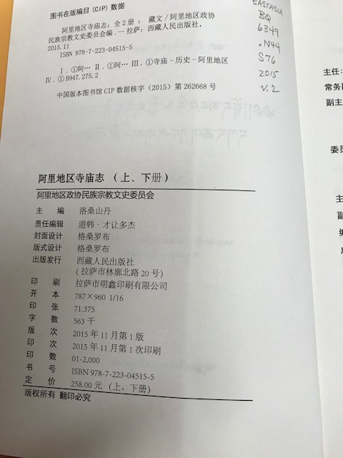

Slide 17
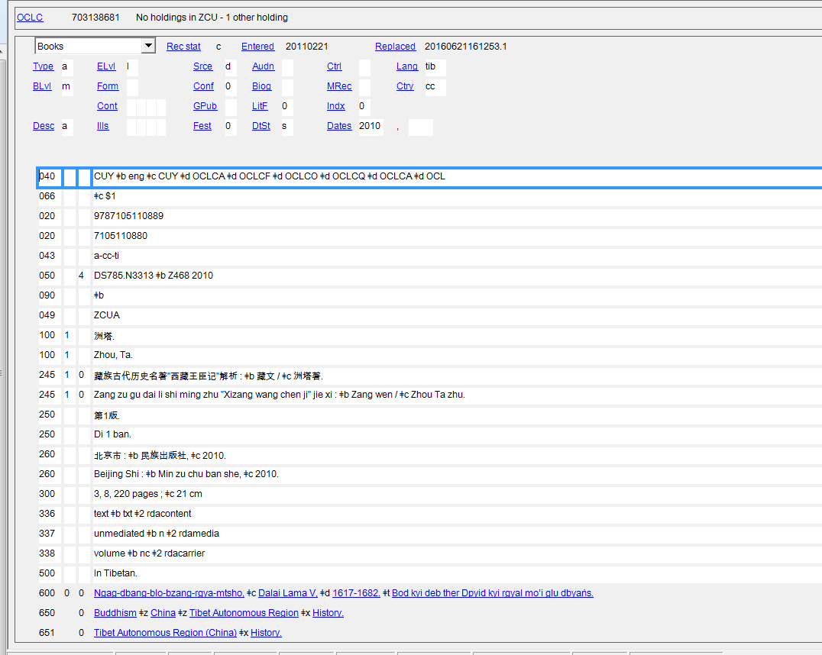
Example 3: Full-level record for Tibetan-language title

Slide 18
ISBN search generates 3 results for same title. Total holdings: 3

Slide 19
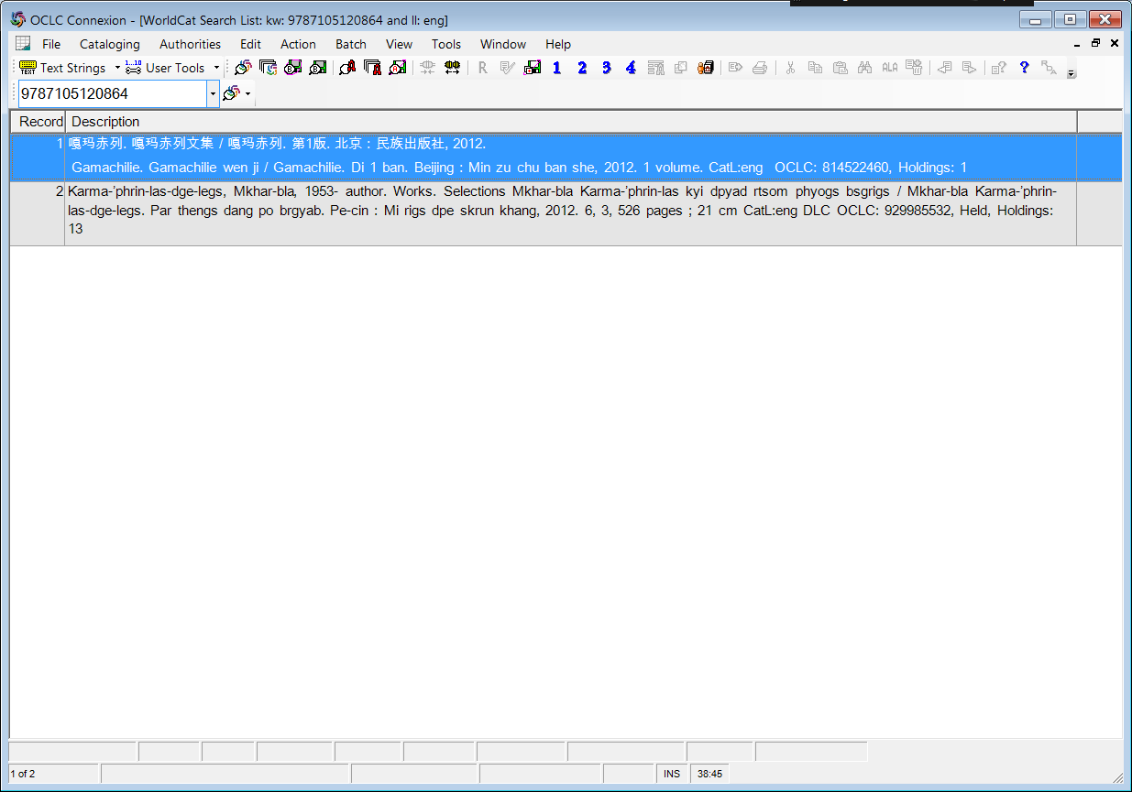
Notes:
We need to be bold in replacing these “eng” records, or we will continue to have duplicates for most titles:

Slide 20
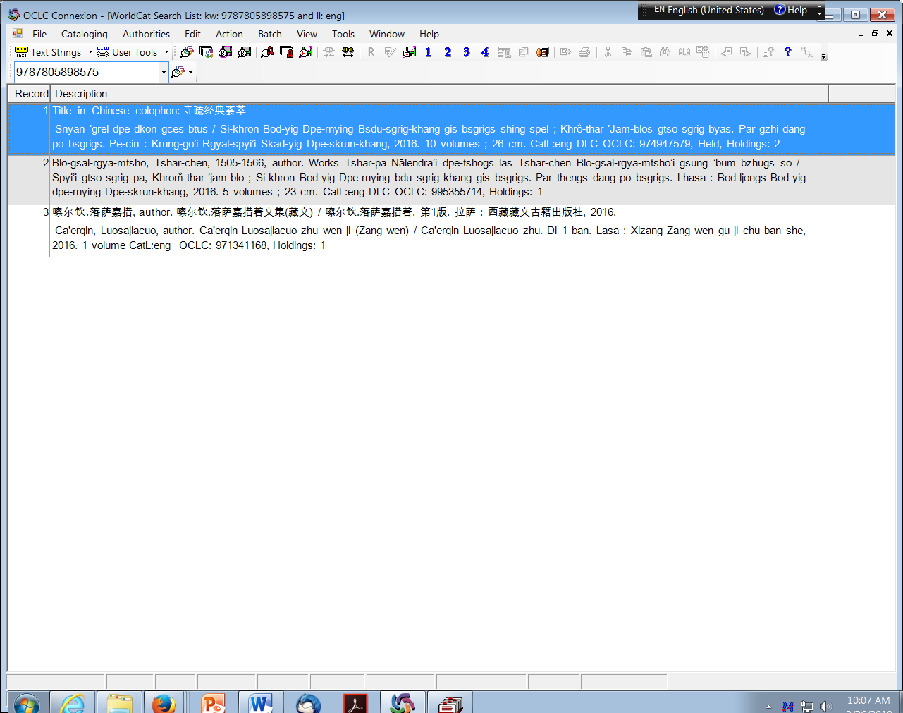
Two records for the same title. The DLC record was added later, but did not automatically replace the earlier-created vendor record which is “eng.” (The “1 volume” is simply erroneous. These truly do refer to the same 5-volume set.)

Slide 21
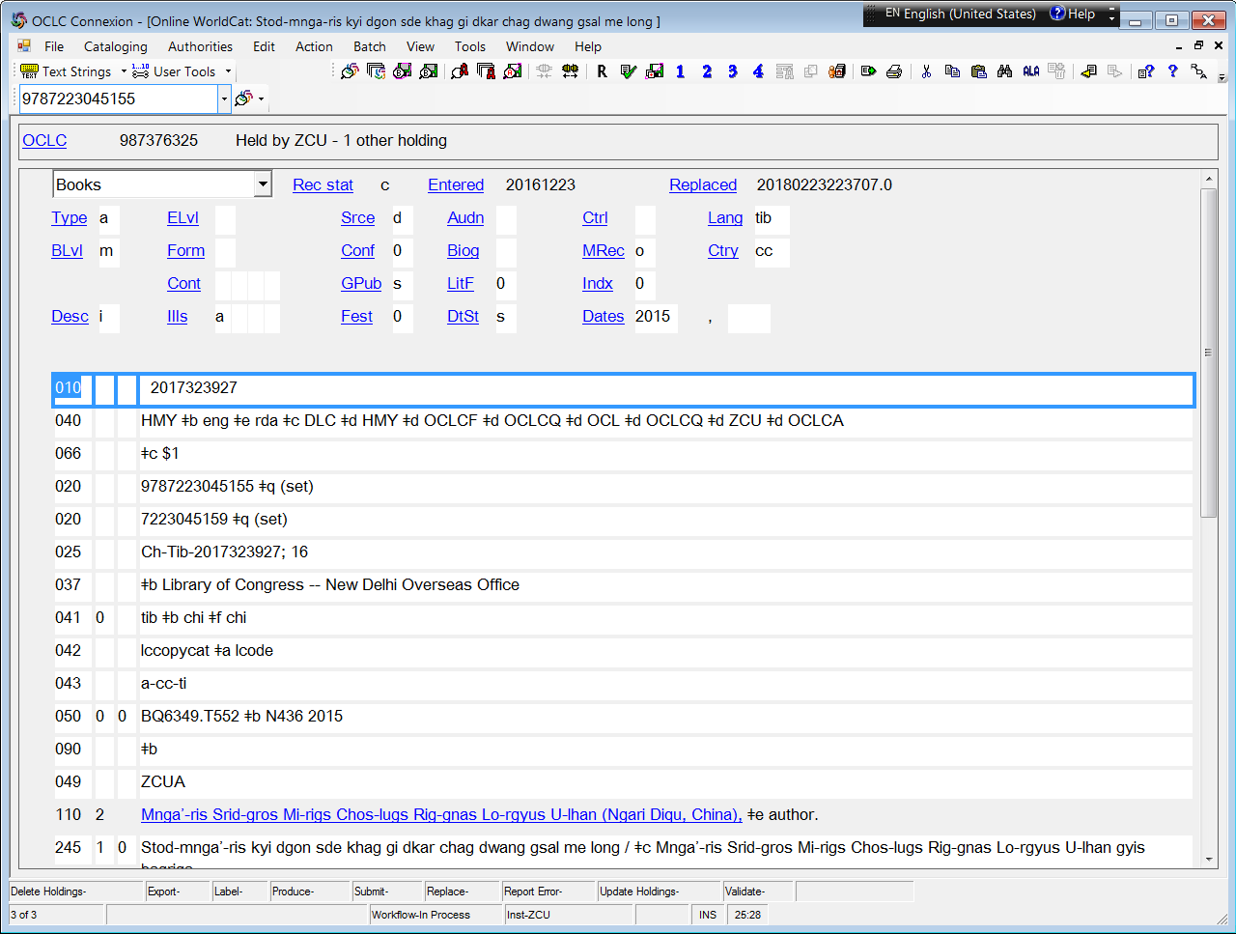

Slide 22
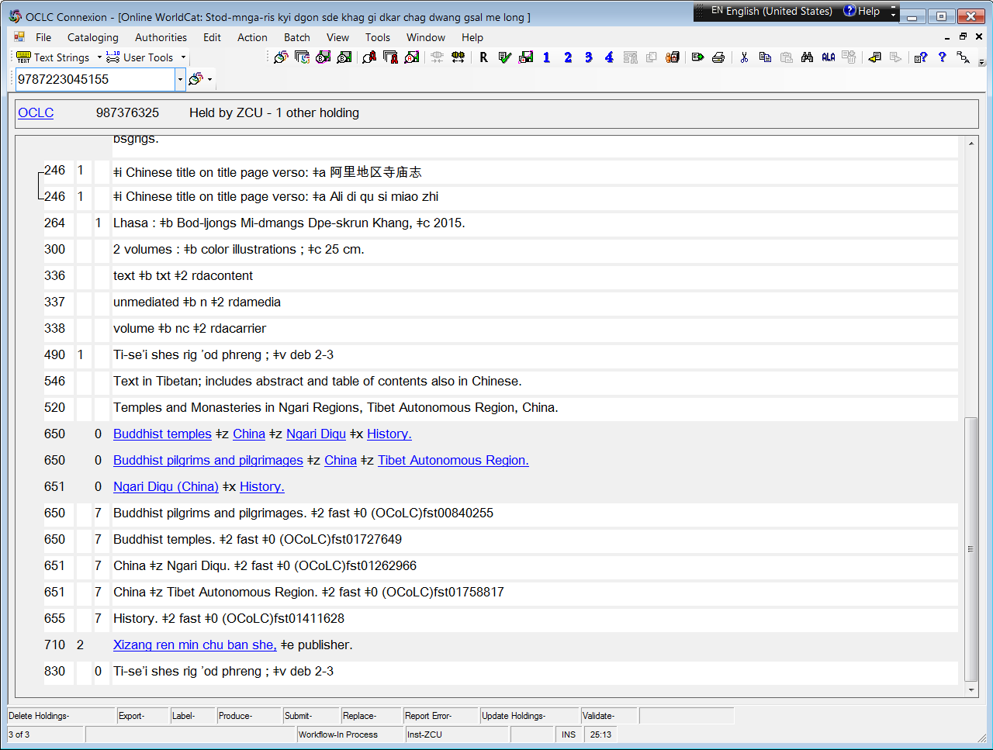

Slide 26
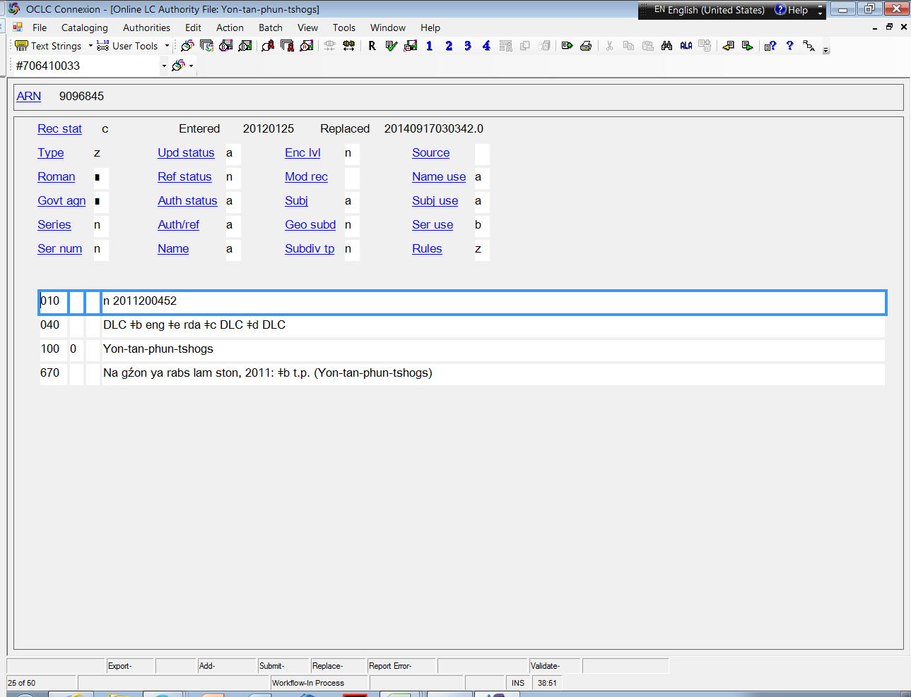

Slide 27
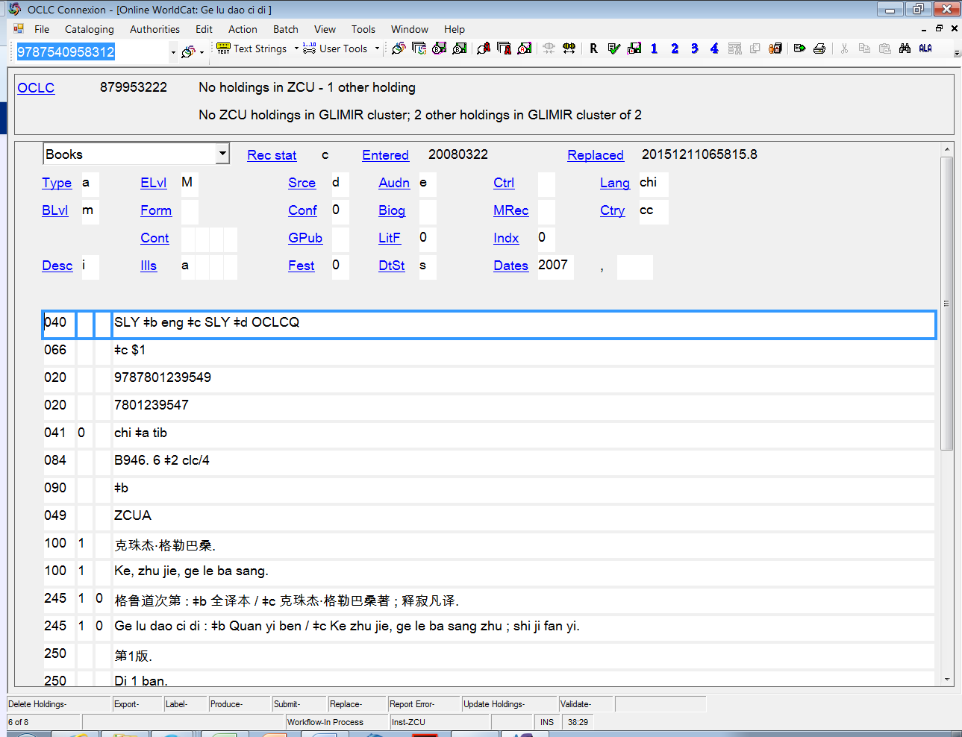
This “eng” record is for the Chinese translation of a Tibetan work. The record is correctly encoded “M” and “chi”. (The 041 should include a sub-field “$h tib” for the original language.) This example demonstrates the importance of seeking support for the 100-field and related authority record….

Slide 28
The “name” in the 100 field (Ke, zhu jie, ge le ba sang) is a religious teacher. Here is the existing NAR:
100 0 # Mkhas-grub Dge-legs-dpal-bzaṅ-po, ǂd 1385-1438
400 0 # Mkhas-grub-rje, ǂd 1385-1438

Slide 29
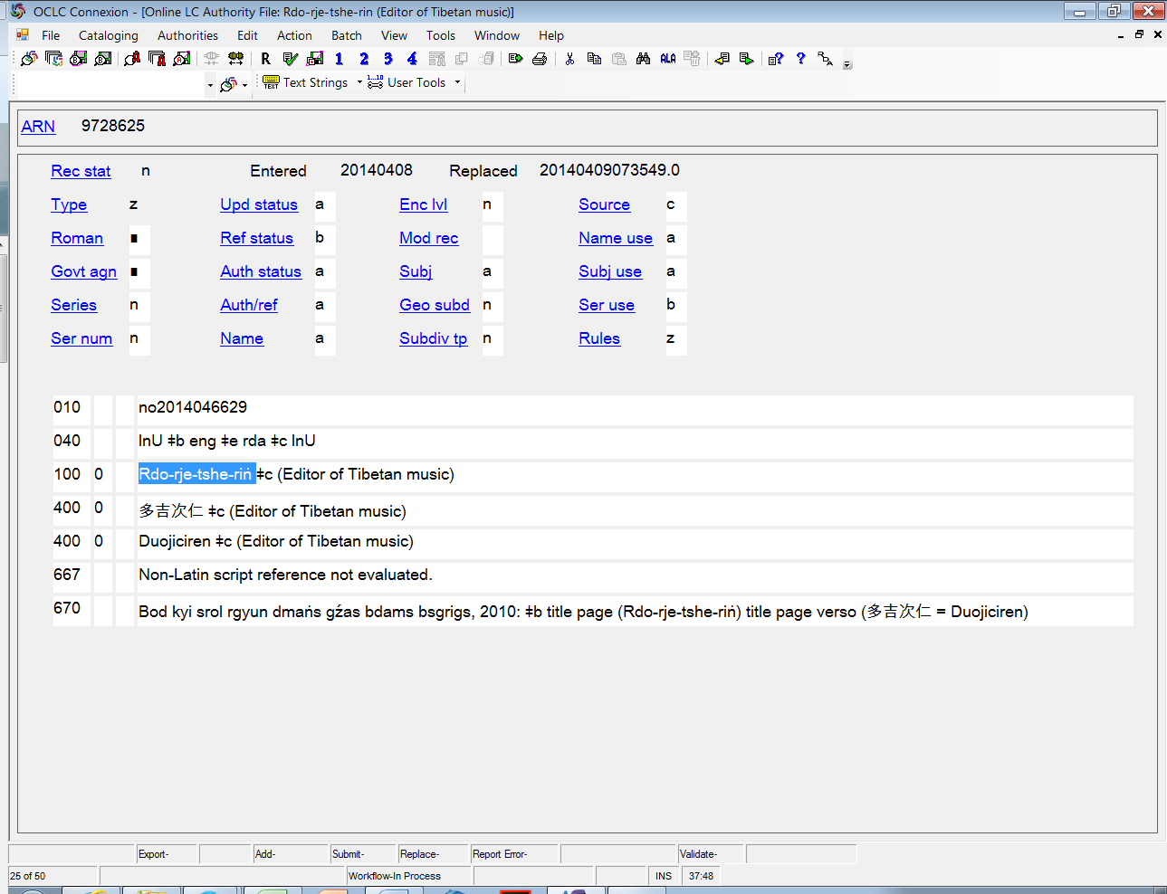
Chinese form of name helpfully added in 400-field.
Notes:
In the record above, the Tibetan form of the name was used and the Chinese form added as a 400. Please remember: following the Tibetan romanization revision, the diacritics ṅ ñ ś ź are no longer used. They have been replaced, respectively, with: nga nya sha zha.
The record above needs to be updated to: Rdo-rje-tshe-ring
The title in the 670 is now romanized as follows: Bod kyi srol rgyun dmangs gzhas bdams bsgrigs, 2010

Slide 30
Tibetan Resources Working Group
Contacts:
Susan Meinheit, Tibetan and Mongolian Specialist, Library of Congress
smei@loc.gov
Lauran Hartley, Tibetan Studies Librarian,
C.V. Starr East Asian Library, Columbia University
lh2112@columbia.edu

